Slide 1
Soil fertility and plant growth management
Future
Supervisor : Dr. Amalraj C.R.J.
Kisojan J. 164070B
Kajaroopan R. 174064U
Silva S.N.D 174162T
Mosikanan G. 174103P

Slide 2
Introduction
Soil fertility is the power of soil to maintain plant growth for long and improve agricultural production in an effective and efficient way. Because of the use of artificial fertilizers the overall food chain is threatened.
By the pandemic globe realized natural fertilizers are the best choice for the longevity of the globe and organisms. Every individual can grow their own food according to their soil type and with a proper disease management. But they have lack of knowledge. With the help of technology we can enhance it and restore our earth back.

Slide 3
Project / Research Problem
Anuruddha Padeniya, President of the Government Medical Officers' Association stated that Sri Lanka has become the country that consumes the most toxic foods in the world.Nowadays soil biology has being affected because of use of synthetic inorganic fertilizers. With a sudden change of the agriculture method the people in the country facing tremendous issue in farming. Peoples cant harvest vegetable as they usually harvest in the past year. Its important to acquire a knowledge from top to bottom to gain success in organic farming; where technology going to interact. Application of the inorganic fertilizer which contain plant nutrients such as nitrogen, phosphorus, and potassium are used as a supplement for the plant growth can affect soil health by forming soil surface as hard, it will reduce the pH of the soil and make the soil acidic in character, it will cause the microbes to die. But the organic fertilizer not. The intensive need for the food day by day because of global situation is another indirect problem we are going to face in near future.
So, Its a great challenge for farmers to turn in to organic agriculture.

Slide 4
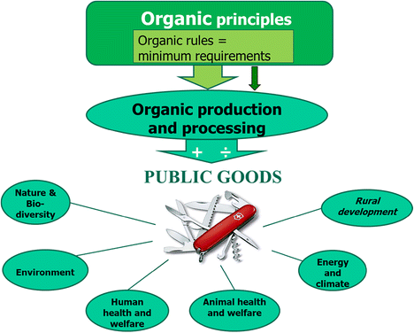
Organic principles

Slide 5
Project/Research Objectives
Detected the type of the soil in a random place to make effective growth for each plant variety..
Studied about the NPK levels for the crops to gather nutrient deficiency corelate with the leaf color.
Studied the elements in organic fertilizers like Panchagavya, Jeevemrutham, Beejamrutha, five leaf solution etc. to resolve the nutrient deficiency.
Detected the nutrient deficiency of the crop and give suggestion for organic fertilizers usage through the image processing approach.
Detected the cultivatable crops in the random place according to the type of soil and with the data collected and the nutrient values from traditional farmers.
Quick smart assistant to provide clear linguistic based soliton for the nutrient and nutrient deficiency as well as organic fertilizers information.

Slide 6
High Level Architecture / Concept map of the Project
Deficiency images
Fertilizers
Soil samples images
Plant type
Preprocessing and analyzing
Suggesting organic fertilizers
Smart assistant system

Slide 7
Solutions in Detail (Modules)

Slide 8
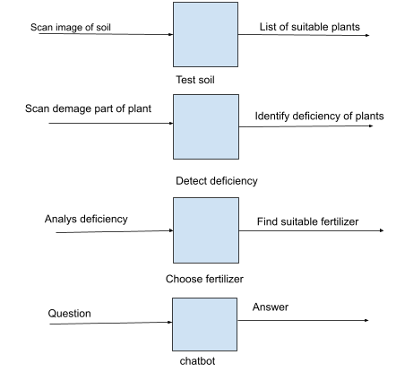
Overall Module’s Inputs and Outputs

Slide 9
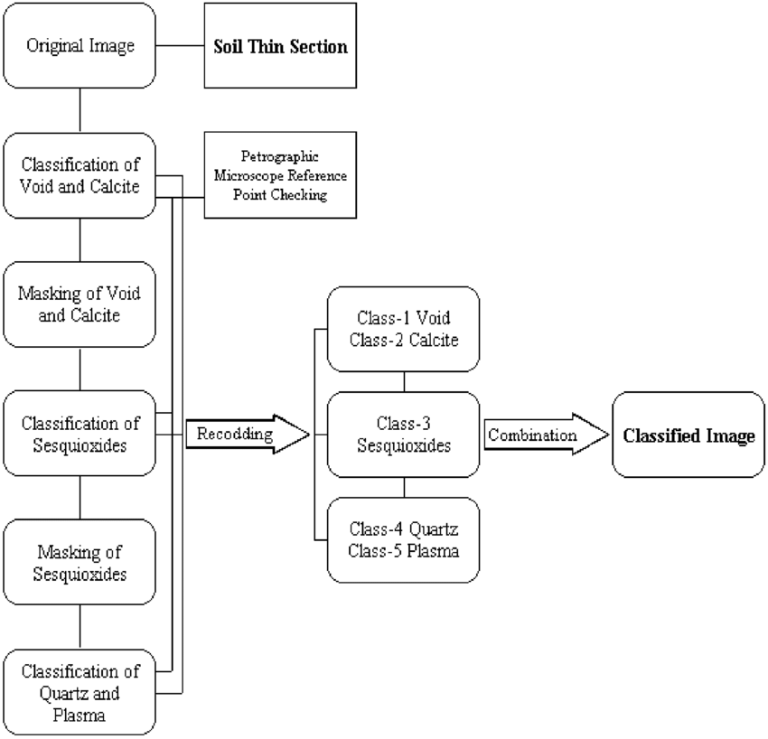
Soil type identification

Slide 10
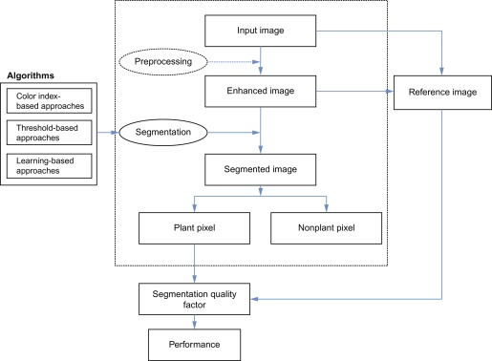
Nutrient deficiency identification

Slide 11
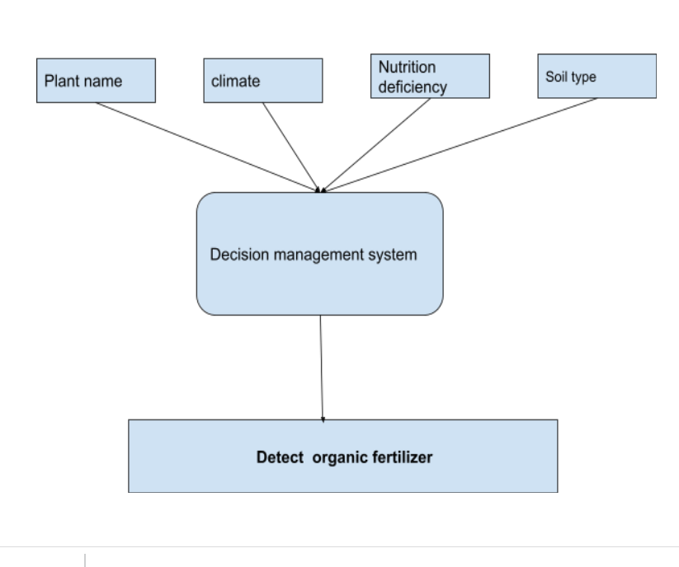
Fertilizer recommendation

Slide 12
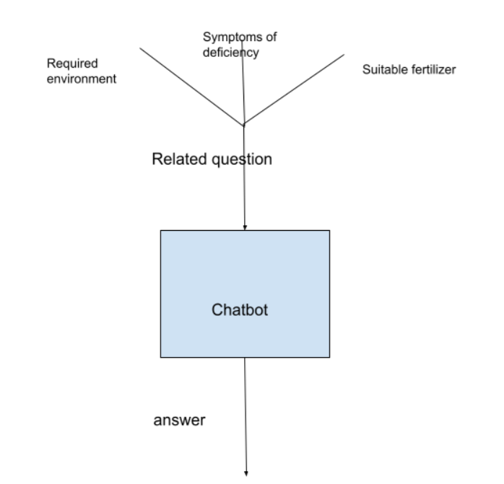
NLP chatbot
Domain of the chatbot

Slide 13
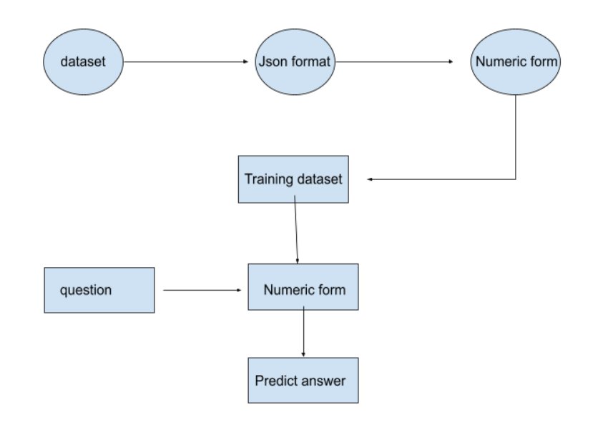
Process of chatbot

Slide 14
Project Approach
The soils from different areas are collected and studied with their physical characteristics as well The data sets are collected from traditional farmers and experts as well as the regional agriculture extension offices in the areas. Initialized python to start the image processing acquisition technique with the vs code with core libraries. The leaf deficiencies are gathered from the agricultural department and knowledgeful experts. The organic fertilizer information are gathered and plants have been grown under the environmental and nutrient conditions. The decision support system which help to resolve this nutrient deficiency to the customers.

Slide 15
Project Requirements
The data sets are collected form traditional farmers and experts as well as the regional agriculture extension offices in the areas.
Operating system: Linux- Ubuntu 16.04 to 17.10, or Windows 7 to 10, with 2GB RAM (4GB preferable)
Python 3.6
React native
spring boot
NPM
Vs code/web storm
The application can be used by the individual peoples and farmers as well as entrepreneurs and new startup farmers as well as the young students to give a fundamental knowledge about organic agriculture.

Slide 16
Conclusions / Discussion / Summary
The laboratory experiments are ongoing in these discussed fields and there have to be a high level architectural applications want to be build through the react native frame work for the front end and spring boot as well as Node.js have to be used as the server side scripting. The final result will provide a clear scope of this project in a great extend. The nutrients and deficiencies with the leaf color changes are skillfully studied with some agricultural inspector experts in different parts of the country.

Slide 17
List of References
B. Vanlauwe, A. B. (2001). Integrated Soil Fertility Management: Operational Definition and Consequences for Implementation and Dissemination.
Hardy Schulz ,Bruno Glaser. (2012). Effects of biochar compared to organic and inorganic fertilizers on soil quality and plant growth in a greenhouse experiment. Plant nutrient and journal science.
James F. Power, Rajendra Prasad. (1997). Soil Fertility Management for Sustainable Agriculture. Lewis.
Mohd Mazid, T. A. (2014). Future of Bio-fertilizers in Indian agriculture: An Overview. canada.
Rui Zhang & Brian J. Wienhold . (2002). The effect of soil moisture on mineral nitrogen, soil electrical conductivity, and pH.
Ukrit Watchareeruetai; Pavit Noinongyao; Chaiwat Wattanapaiboonsuk; Puriwat Khantiviriya; Sutsawat Duangsrisai. (2018). Identification of Plant Nutrient Deficiencies Using Convolutional Neural Networks. IEEE.

